Slide 1
Creating and Managing and Teams
Chapter
13
© 2007 Prentice Hall, Inc.
All rights reserved.

Slide 2
L E A R N I N G O U T L I N E
Follow this Learning Outline as you read and study this chapter.
Understanding Groups
  Define the different types of groups.
  Describe the five stages of group development.
Explaining Work Group Behavior
  Explain the major components that determine group performance and satisfaction.
  Discuss how roles, norms, conformity, status systems, group size, and group cohesiveness influence group behavior.
  Explain how group norms can both help and hurt an organization.
  Define groupthink and social loafing.
© 2007 Prentice Hall, Inc. All rights reserved.
15–<number>

Slide 3
L E A R N I N G O U T L I N E (cont’d)
Follow this Learning Outline as you read and study this chapter.
Explaining Work Group Behavior (cont’d)
  Describe the relationships between group cohesiveness and productivity.
  Discuss how conflict management influences group behavior.
  Tell the advantages and disadvantages of group decision making.
Creating Effective Teams
  Compare groups and teams.
  Explain why teams have become so popular in organizations.
  Describe the four most common types of teams.
© 2007 Prentice Hall, Inc. All rights reserved.
15–<number>

Slide 4
L E A R N I N G O U T L I N E (cont’d)
Follow this Learning Outline as you read and study this chapter.
Creating Effective Teams (cont’d)
  List the characteristics of effective teams.
Current Challenges in Managing Teams
  Discuss the challenges of managing global teams
  Explain the role of informal (social) networks in managing teams.
© 2007 Prentice Hall, Inc. All rights reserved.
15–<number>

Slide 5
Understanding Groups
Group
  Two or more interacting and interdependent individuals who come together to achieve specific goals.
  Formal groups
    Work groups defined by the organization’s structure that have designated work assignments and tasks.
      Appropriate behaviors are defined by and directed toward organizational goals.
  Informal groups
    Groups that are independently formed to meet the social needs of their members.
© 2007 Prentice Hall, Inc. All rights reserved.
15–<number>

Slide 6
Scenario: Project Team in a Marketing Department
Group Description:
A company forms a marketing project team to launch a new product. This team consists of:
Sarah (Marketing Manager)
James (Graphic Designer)
Lena (Content Writer)
Arjun (Data Analyst)
Goal:
To develop and execute a marketing campaign for the launch of a new smartwatch within 3 months.
Interdependence & Interaction:
Sarah sets the campaign strategy and oversees progress.
Lena writes engaging promotional content for the website and ads.
James creates visuals and advertisements based on Lena’s content.
Arjun analyzes customer data to identify target audiences and provides insights that shape the campaign.
They hold weekly meetings to review progress, share feedback, and adjust plans based on market response.
Why This Is a Group:
They interact regularly, collaborate on tasks, and depend on each other's work to succeed.
They have a shared goal (successful product launch).
They are interdependent — one person's output directly impacts the team's ability to meet its goal.
© 2007 Prentice Hall, Inc. All rights reserved.
1–<number>

Slide 7
Scenario: Formal Group in a Bank
Group Name:
Loan Approval Committee at a Commercial Bank
Members:
Branch Manager (Chairperson)
Loan Officer
Risk Analyst
Legal Advisor
Purpose/Goal:
To review and approve business loan applications above Rs100,000.
Structure & Roles:
The Loan Officer presents loan application details.
The Risk Analyst evaluates financial risks and repayment ability.
The Legal Advisor checks for legal compliance and documentation.
The Branch Manager leads the meeting and makes final decisions based on input.
Why This Is a Formal Group:
Formed by the bank’s organizational structure
Members are assigned specific roles by management
Tasked with a clear organizational objective (loan assessment)
Operations follow formal rules and procedures
© 2007 Prentice Hall, Inc. All rights reserved.
1–<number>

Slide 8
✅ Example & Scenario: Informal Group at University
Scenario:
In a University, a group of friends regularly meets in the library to study together, even though they are not assigned to the same project or group by a teacher.
Group Members:
Fatima
Nabil
Hira
Sam
Common Purpose:
They all want to do well in their exams and prefer to study together because:
They trust each other
They help explain difficult topics
They motivate each other to stay focused
They meet during lunch breaks, share notes, quiz each other, and sometimes relax after studying.
Why This Is an Informal Group:
Formed naturally through friendship
No official structure or assignment
Shared interest in doing well academically
Exists even without teacher or management direction
© 2007 Prentice Hall, Inc. All rights reserved.
1–<number>

Slide 9
Exhibit 15–1 Examples of Formal Groups
Command Groups
  Groups that are determined by the organization chart and composed of individuals who report directly to a given manager.
Task Groups
  Groups composed of individuals brought together to complete a specific job task; their existence is often temporary because once the task is completed, the group disbands.
© 2007 Prentice Hall, Inc. All rights reserved.
15–<number>

Slide 10
Exhibit 15–1 Examples of Formal Groups (cont’d)
Cross-Functional Teams
  Groups that bring together the knowledge and skills of individuals from various work areas or groups whose members have been trained to do each others’ jobs.
Self-Managed Teams
  Groups that are essentially independent and in addition to their own tasks, take on traditional responsibilities such as hiring, planning and scheduling, and performance evaluations.
© 2007 Prentice Hall, Inc. All rights reserved.
15–<number>

Slide 11
✅ Example of a Cross-Functional Team
A mobile phone company wants to launch a new smartphone model.
To make this happen, they form a cross-functional team that includes experts from different departments.
Team Members:
Product Manager – oversees project timeline and objectives
Engineer – works on the hardware and technical specs
Software Developer – designs the phone’s operating system and apps
Marketing Specialist – creates promotional strategies and ad campaigns
Finance Analyst – manages the budget and cost estimates
Customer Service Rep – provides insights from customer feedback
Purpose of the Team:
To collaborate on designing, building, marketing, and launching the new smartphone successfully.
Each member brings unique knowledge and skills from their department, and they may also be trained to understand each other's roles to work more effectively as a team.
© 2007 Prentice Hall, Inc. All rights reserved.
1–<number>

Slide 12
✅ Example of a Self-Managed Team
A furniture manufacturing company uses self-managed teams on the factory floor to handle the production of office chairs.
Team Members:
6 skilled workers (machine operators, assemblers, quality checkers)
Responsibilities:
In addition to assembling and producing the chairs, the team also:
Plans the daily and weekly production schedule
Assigns tasks among themselves based on skills and availability
Hires and trains new team members when needed
Monitors performance and gives feedback to each other
Handles minor maintenance of their equipment
They do not report to a direct supervisor on a daily basis. Instead, they meet once a week with upper management for updates.
© 2007 Prentice Hall, Inc. All rights reserved.
1–<number>

Slide 13
ANOTHER EXAMPLE:
Software Development Company:
A self-managed software team is responsible for developing and maintaining a mobile app. The team:
Sets its own deadlines and work methods
Divides work among developers, testers, and designers
Hires freelancers when needed
Reviews each other’s code and performance
Communicates directly with clients
Again, there's no daily manager—they manage themselves.
© 2007 Prentice Hall, Inc. All rights reserved.
1–<number>

Slide 14
Stages in Group Development
Forming
  The first stage of group development in which people join the group and then define the group’s purpose, structure, and leadership
Storming
  The second stage of group development, characterized by intragroup conflict.
Norming
  The third stage of group development, characterized by close relationships and cohesiveness
Performing
  The fourth stage of group development when the group is fully functional and works on group task
Adjourning
  The final stage of group development for temporary groups during which group members are concerned with wrapping up activities rather than task performance
© 2007 Prentice Hall, Inc. All rights reserved.
15–<number>

Slide 15
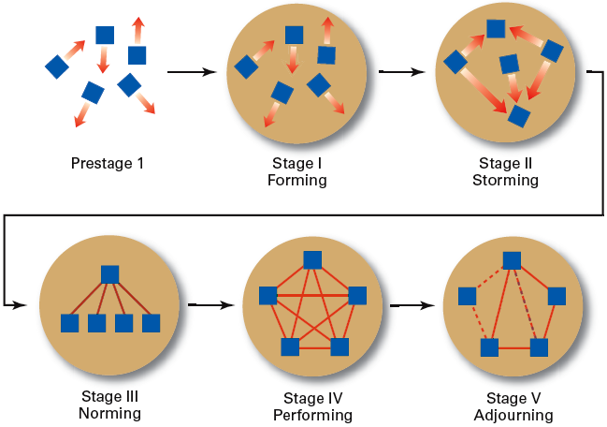
Exhibit 15–2 Stages of Group Development
© 2007 Prentice Hall, Inc. All rights reserved.
15–<number>

Slide 16
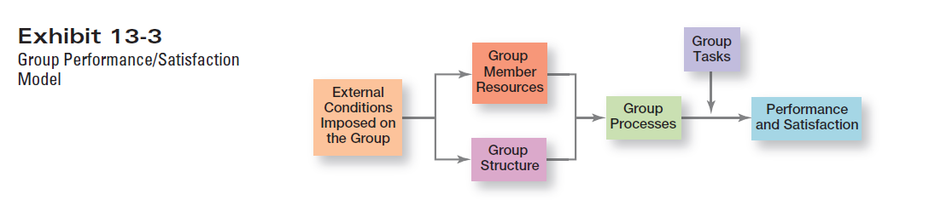
© 2007 Prentice Hall, Inc. All rights reserved.
1–<number>

Slide 17
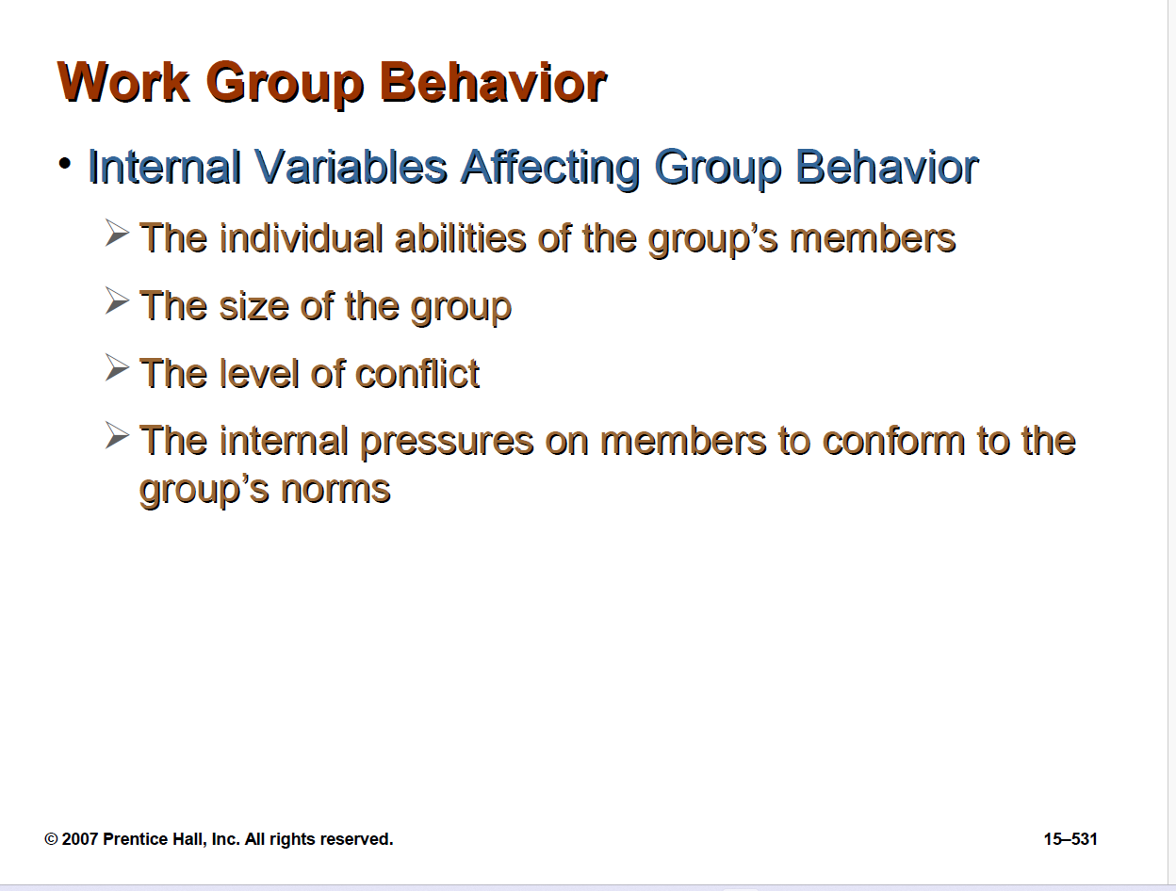
© 2007 Prentice Hall, Inc. All rights reserved.
1–<number>

Slide 18
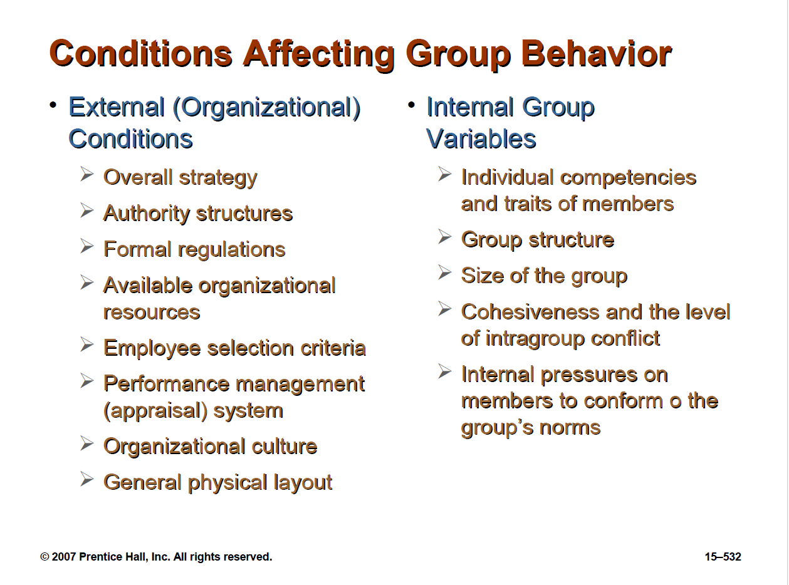
© 2007 Prentice Hall, Inc. All rights reserved.
1–<number>

Slide 19
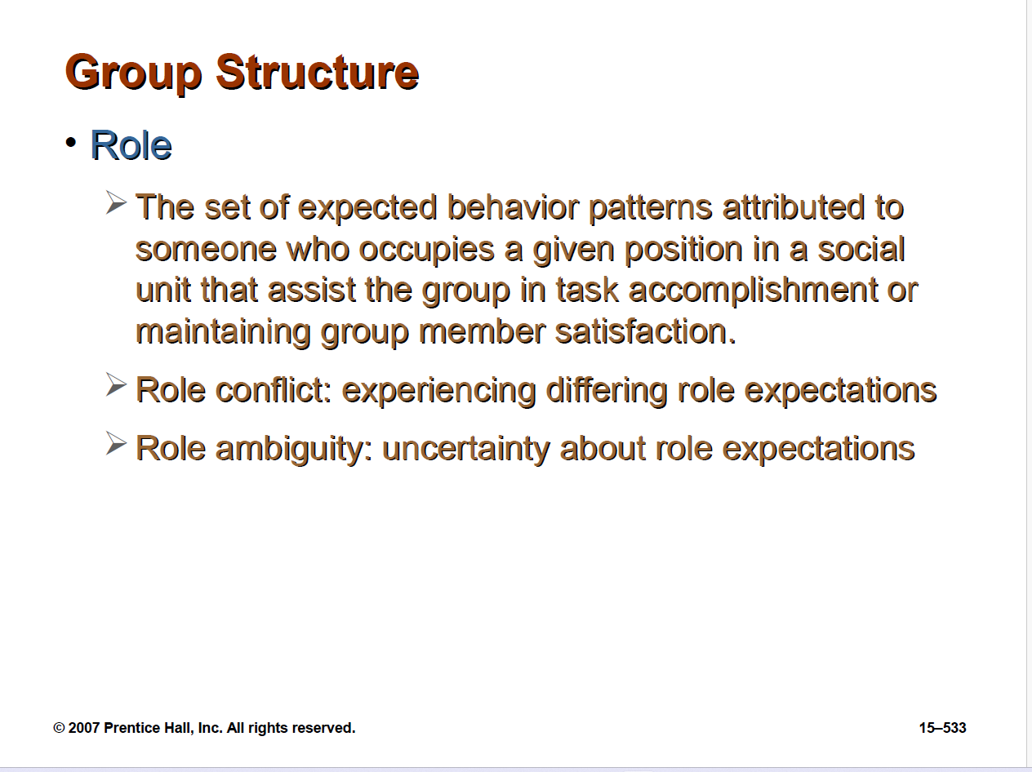
© 2007 Prentice Hall, Inc. All rights reserved.
1–<number>

Slide 20
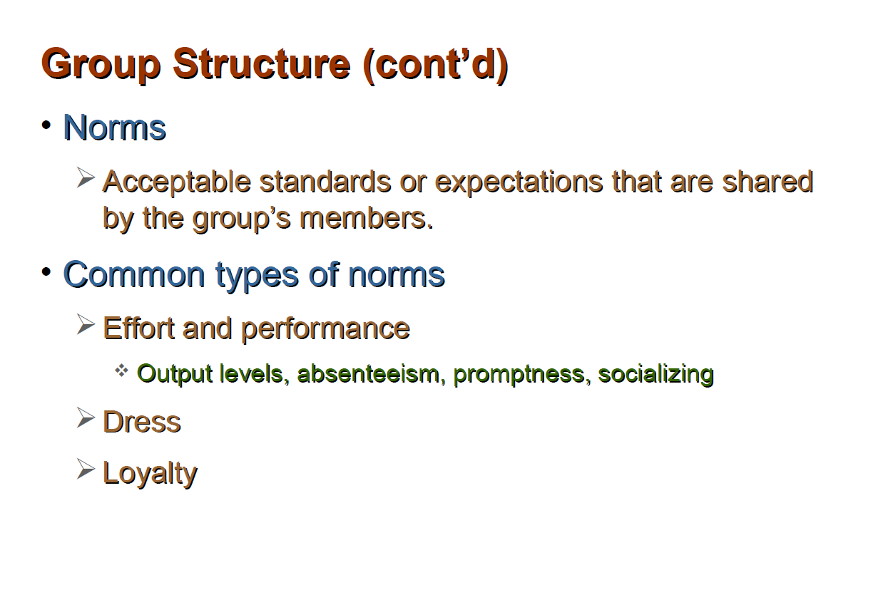
© 2007 Prentice Hall, Inc. All rights reserved.
1–<number>

Slide 21
Common Types of Norms
👉 Effort and Performance Norms
These norms govern how much work or effort is expected from members.
  Output levels: How productive members should be (e.g., meeting sales targets).
  Absenteeism: Expectations around attendance or being present.
  Promptness: Being on time to meetings or tasks.
  Socializing: How much casual conversation or interaction is acceptable during work hours.
2.👉 Dress Norms
  Expectations for how group members should dress (e.g., formal vs. casual attire).
  This can vary by workplace culture, role, or industry.
3.👉 Loyalty Norms
  Expectations around allegiance and commitment to the group or organization.
  Could involve protecting group interests, supporting team decisions, or staying with the company long-term.
© 2007 Prentice Hall, Inc. All rights reserved.
1–<number>

Slide 22
Group Structure (cont’d)
Conformity
✅ What is Conformity?
Conformity is when individuals adjust their behavior, attitudes, or beliefs to match those of a group. This often happens because people want to be accepted, liked, or respected by others in the group.
  Group pressures can have an effect on an individual member’s judgment and attitudes.
  Groupthink
  When a group exerts extensive pressure on an individual to align his or her opinion with others’ opinions.
© 2007 Prentice Hall, Inc. All rights reserved.
15–<number>

Slide 23
✅ What is Groupthink?
Groupthink happens when the desire for harmony and agreement becomes more important than making the right decision.
In such groups, members suppress doubts, avoid conflict, and go along with decisions—even bad ones.
🔍 Example:
A business team might ignore warning signs of a bad investment because everyone wants to show unity.
© 2007 Prentice Hall, Inc. All rights reserved.
1–<number>

Slide 24
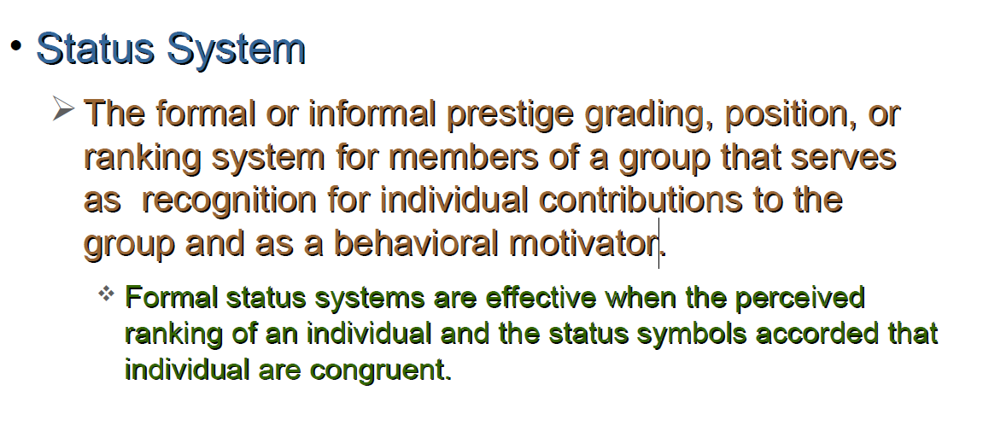
Group Structure (cont’d)
Status
A prestige grading, position, or rank
within a group.
© 2007 Prentice Hall, Inc. All rights reserved.
15–<number>

Slide 25
Formal status systems :are systems in organizations that clearly show a person's position or rank, like job titles (e.g., manager, director) or rewards (e.g., office size, company car).
They are effective when:
The rank someone has matches (is congruent with)
The status symbols they receive (like salary, office, title, etc.).
Example:
If someone is a senior manager and they have a big office and high pay, people see that the rank and the rewards match. This makes the system feel fair and effective.
But if a junior employee gets the same perks as a senior manager, people might feel the system is unfair or confusing.
© 2007 Prentice Hall, Inc. All rights reserved.
1–<number>

Slide 26

Group Structure: Group Size
Small groups
  Complete tasks faster than larger groups.
  Make more effective use of facts.
Large groups
  Solve problems better than small groups.
  Are good for getting diverse input.
  Are more effective in fact-finding.
Social Loafing
  The tendency for individuals to expend less effort when working collectively than when work individually.
© 2007 Prentice Hall, Inc. All rights reserved.
15–<number>

Slide 27

Group Structure (cont’d)
Group Cohesiveness
  The degree to which members are attracted to a group and share the group’s goals.
    Highly cohesive groups are more effective and productive than less cohesive groups when their goals aligned with organizational goals.
© 2007 Prentice Hall, Inc. All rights reserved.
15–<number>

Slide 28
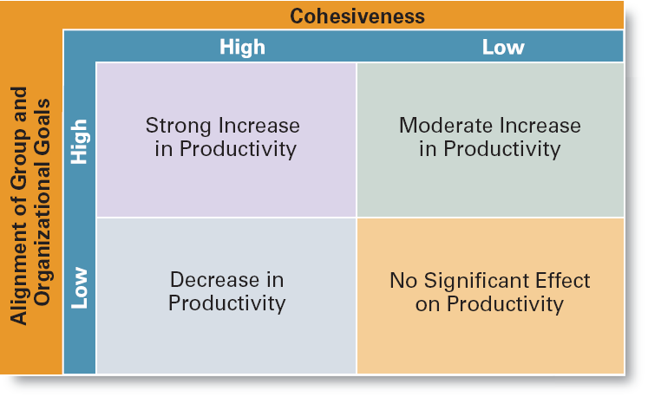
Exhibit 15–5 The Relationship Between Cohesiveness and Productivity
© 2007 Prentice Hall, Inc. All rights reserved.
15–<number>

Slide 29
Group Processes: Group Decision Making
Advantages
  Generates more complete information and knowledge.
  Generates more diverse alternatives.
  Increases acceptance of a solution.
  Increases legitimacy of decision.
Disadvantages
  Time consuming
  Minority domination
  Pressures to conform
  Ambiguous responsibility
© 2007 Prentice Hall, Inc. All rights reserved.
15–<number>

Slide 30
Exhibit 15–6 Group versus Individual Decision Making
Criteria of Effectiveness Groups Individuals
Accuracy ✓
Speed ✓
Creativity ✓
Degree of acceptance ✓
Efficiency ✓
© 2007 Prentice Hall, Inc. All rights reserved.
15–<number>

Slide 31
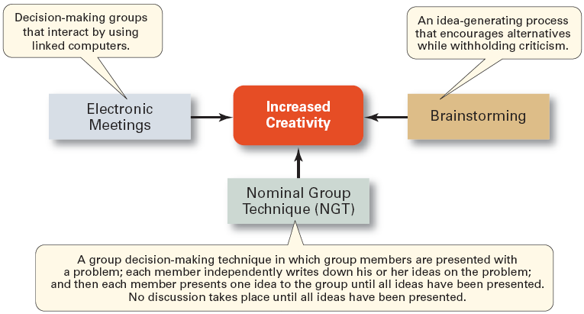
Exhibit 15–7 Techniques for Making More Creative Group Decisions
© 2007 Prentice Hall, Inc. All rights reserved.
15–<number>

Slide 32
Group Processes: Conflict Management
Conflict
  The perceived incompatible differences in a group resulting in some form of interference with or opposition to its assigned tasks.
    Traditional view: conflict must be avoided.
    Human relations view: conflict is a natural and inevitable outcome in any group.
    Interactionist view: conflict can be a positive force and is absolutely necessary for effective group performance.
© 2007 Prentice Hall, Inc. All rights reserved.
15–<number>

Slide 33
Group Processes: Conflict Management (cont’d)
Categories of Conflict
  Functional conflicts are constructive.
  Dysfunctional conflicts are destructive.
Types of Conflict
  Task conflict: content and goals of the work
  Relationship conflict: interpersonal relationships
  Process conflict: how the work gets done
© 2007 Prentice Hall, Inc. All rights reserved.
15–<number>

Slide 34
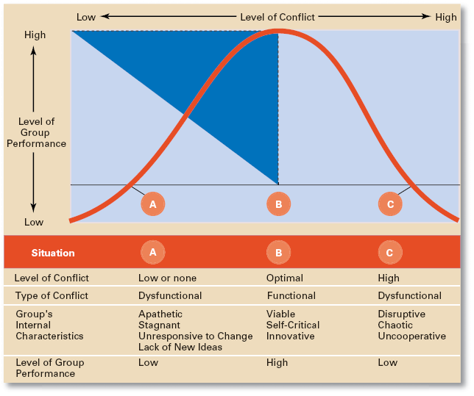
Exhibit 15–8 Conflict and Group Performance
© 2007 Prentice Hall, Inc. All rights reserved.
15–<number>

Slide 35
🔄 Three Conflict Situations (A, B, C):
A. Low or No Conflict
Type of Conflict: Dysfunctional
Group Characteristics:
  Apathetic
  Stagnant
  Unresponsive to change
  Lacks new ideas
Performance: Low
⟶ The group lacks energy or drive because there is no challenge or disagreement.
B. Optimal Conflict (Middle Point of the Curve)
Type of Conflict: Functional
Group Characteristics:
  Viable
  Self-critical
  Innovative
Performance: High
⟶ This is the ideal scenario. The group experiences just enough conflict to encourage creativity, debate, and better decision-making, but not so much that it becomes disruptive.
© 2007 Prentice Hall, Inc. All rights reserved.
1–<number>

Slide 36
C. High Conflict
Type of Conflict: Dysfunctional
Group Characteristics:
  Disruptive
  Chaotic
  Uncooperative
Performance: Low
⟶ Excessive conflict overwhelms the group, leading to breakdowns in communication, hostility, and inefficiency.
© 2007 Prentice Hall, Inc. All rights reserved.
1–<number>

Slide 37
Group Processes: Conflict Management (cont’d)
Techniques to Reduce Conflict:
  Avoidance
  Accommodation
  Forcing
  Compromise
  Collaboration
© 2007 Prentice Hall, Inc. All rights reserved.
15–<number>

Slide 38
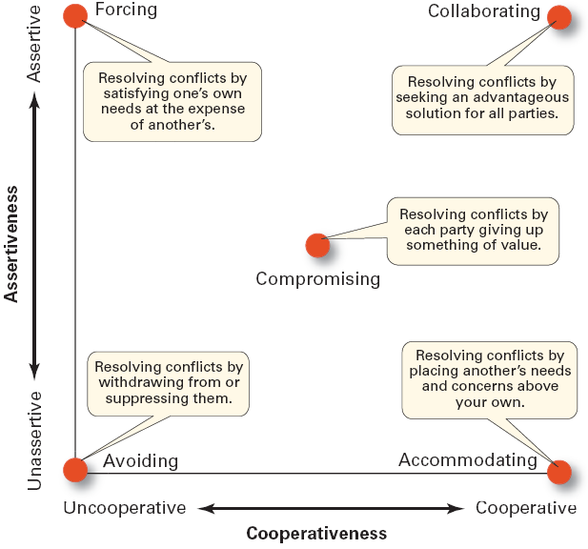
Exhibit 15–9 Conflict-Management Techniques
Source: Adapted from K.W. Thomas, “Conflict and Negotiation Processes in Organizations,” in M.D. Dunnette and L.M. Hough (eds.) Handbook of Industrial and Organizational Psychology, vol. 3, 2d ed. (Palo Alto, CA: Consulting Psychologists Press, 1992), p. 668. With permission
© 2007 Prentice Hall, Inc. All rights reserved.
15–<number>

Slide 39
Group Tasks and Group Effectiveness
Highly complex and interdependent tasks require:
  Effective communications: discussion among group members.
  Controlled conflict: More interaction among group members.
© 2007 Prentice Hall, Inc. All rights reserved.
15–<number>

Slide 40
What Is a Team?
Work Team
  A group whose members work intensely on a specific common goal using their positive synergy, individual and mutual accountability, and complementary skills.
Types of Teams
  Problem-solving teams
  Self-managed work teams
  Cross-functional teams
  Virtual teams
© 2007 Prentice Hall, Inc. All rights reserved.
15–<number>

Slide 41
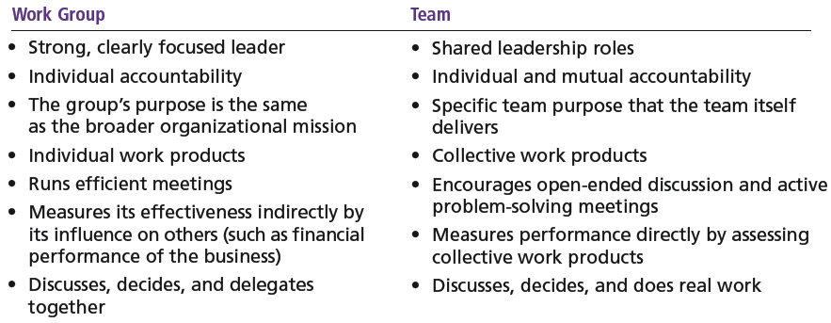
Exhibit 15–10 Groups versus Teams
© 2007 Prentice Hall, Inc. All rights reserved.
15–<number>

Slide 42
Types of Teams
Problem-solving Teams
  Employees from the same department and functional area who are involved in efforts to improve work activities or to solve specific problems.
Self-managed Work Teams
  A formal group of employees who operate without a manager and responsible for a complete work process or segment.
© 2007 Prentice Hall, Inc. All rights reserved.
15–<number>

Slide 43
Types of Teams (cont’d)
Cross-functional Teams
  A hybrid grouping of individuals who are experts in various specialties and who work together on various tasks.
Virtual Teams
  Teams that use computer technology to link physically dispersed members in order to achieve a common goal.
© 2007 Prentice Hall, Inc. All rights reserved.
15–<number>

Slide 44

Advantages of Using Teams
Teams outperform individuals.
Teams provide a way to better use employee talents.
Teams are more flexible and responsive.
Teams can be quickly
assembled, deployed,
refocused, and disbanded.
© 2007 Prentice Hall, Inc. All rights reserved.
15–<number>

Slide 45
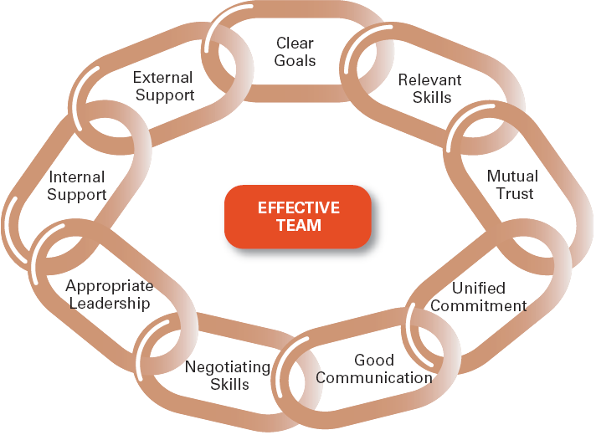
Exhibit 15–11 Characteristics of Effective Teams
© 2007 Prentice Hall, Inc. All rights reserved.
15–<number>

Slide 46
Characteristics of Effective Teams
Have a clear understanding of their goals.
Have competent members with relevant technical and interpersonal skills.
Exhibit high mutual trust in the character and integrity of their members.
Are unified in their commitment to team goals.
Have good communication systems.
Possess effective negotiating skills
Have appropriate leadership
Have both internally and externally supportive environments
© 2007 Prentice Hall, Inc. All rights reserved.
15–<number>

Slide 47

Current Challenges in Managing Teams
Getting employees to:
  Cooperate with others
  Share information
  Confront differences
  Sublimate personal interest for the greater good of the team
© 2007 Prentice Hall, Inc. All rights reserved.
15–<number>

Slide 48
Managing Global Teams
Group Member Resources
  Unique cultural characteristics of team members
  Avoiding stereotyping
Group Structure
  Conformity—less groupthink
  Status—varies in importance among cultures
  Social loafing—predominately a Western bias
  Cohesiveness—more difficult to achieve
Group processes—capitalize on diverse ideas
Manager’s role—a communicator sensitive to the type of globe team to use.
© 2007 Prentice Hall, Inc. All rights reserved.
15–<number>

Slide 49
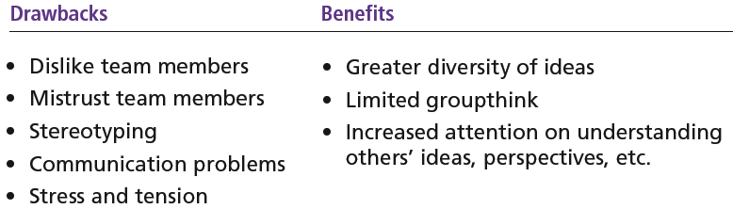
Exhibit 15–12 Drawbacks and Benefits of Global Teams
© 2007 Prentice Hall, Inc. All rights reserved.
15–<number>

Slide 50

Understanding Social Networks
Social Network
  The patterns of informal connections among individuals within groups
The Importance of Social Networks
  Relationships can help or hinder team effectiveness
  Relationships improve team goal attainment and increase member commitment to the team.
© 2007 Prentice Hall, Inc. All rights reserved.
15–<number>

Slide 51
Terms to Know
group
forming
storming
norming
performing
adjourning
role
norms
groupthink
status
social loafing
group cohesiveness
conflict
traditional view of conflict
human relations view of conflict
interactionist view of conflict
functional conflicts
dysfunctional conflicts
task conflict
relationship conflict
process conflict
work teams
© 2007 Prentice Hall, Inc. All rights reserved.
15–<number>

